Slide 1
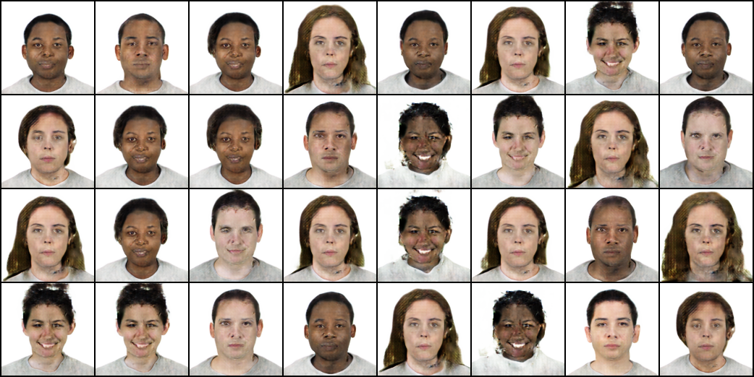
Generative
visual models

Slide 2
Generative
visual models
“What I cannot create, I do not understand.”
— Richard Feynman

Slide 3
G E N E R A T I V E V I S U A L M O D E L S
Goal of generative models
Modeling complex high dimentional data in respect of examples distribution
Goal of generative visual models
Generating real-life looking images with low-level and high level visual patterns distribution based on examples pattern distribution (learning visual manifold of data)

Slide 4
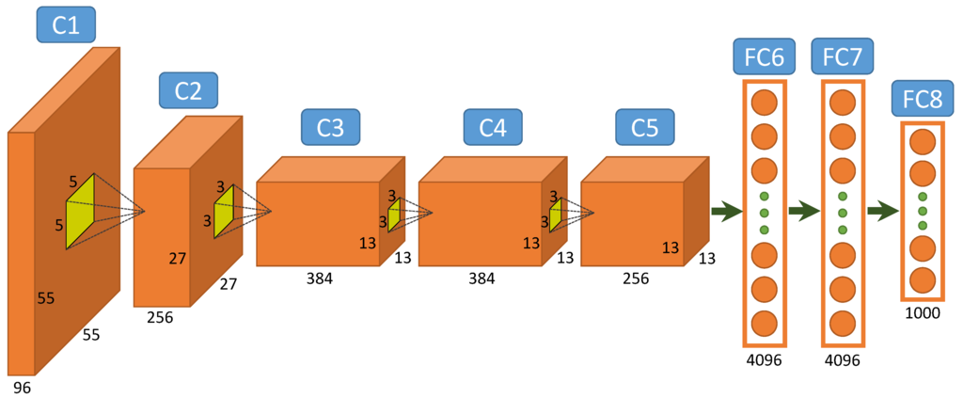
G E N E R A T I V E V I S U A L M O D E L S
How do non-generative visual models work?
Convolutional neural networks:
supervized training

Slide 5
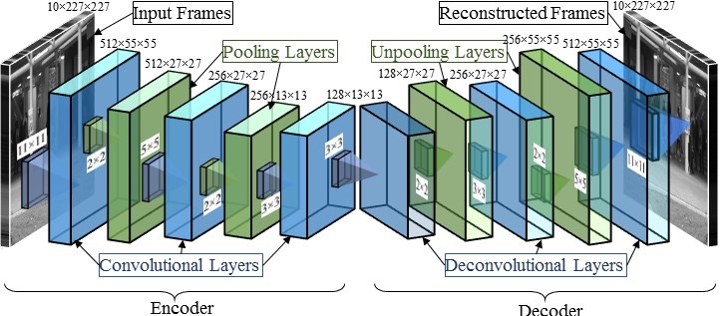
G E N E R A T I V E V I S U A L M O D E L S
Сonvolutional autoencoder: unsupervized training

Slide 6
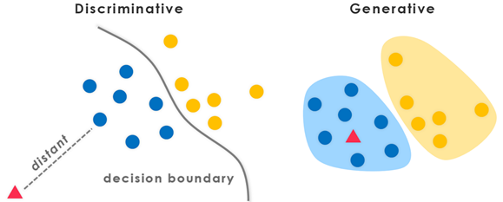
G E N E R A T I V E V I S U A L M O D E L S

Slide 7
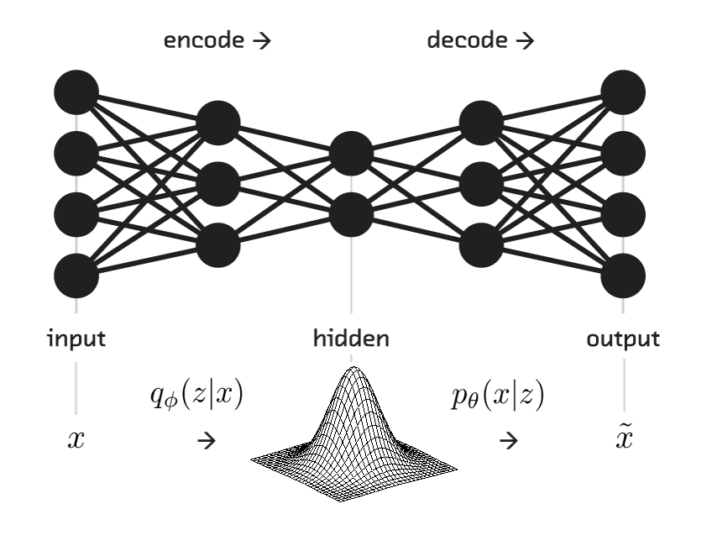
G E N E R A T I V E V I S U A L M O D E L S
Variational autoencoder:

Slide 8
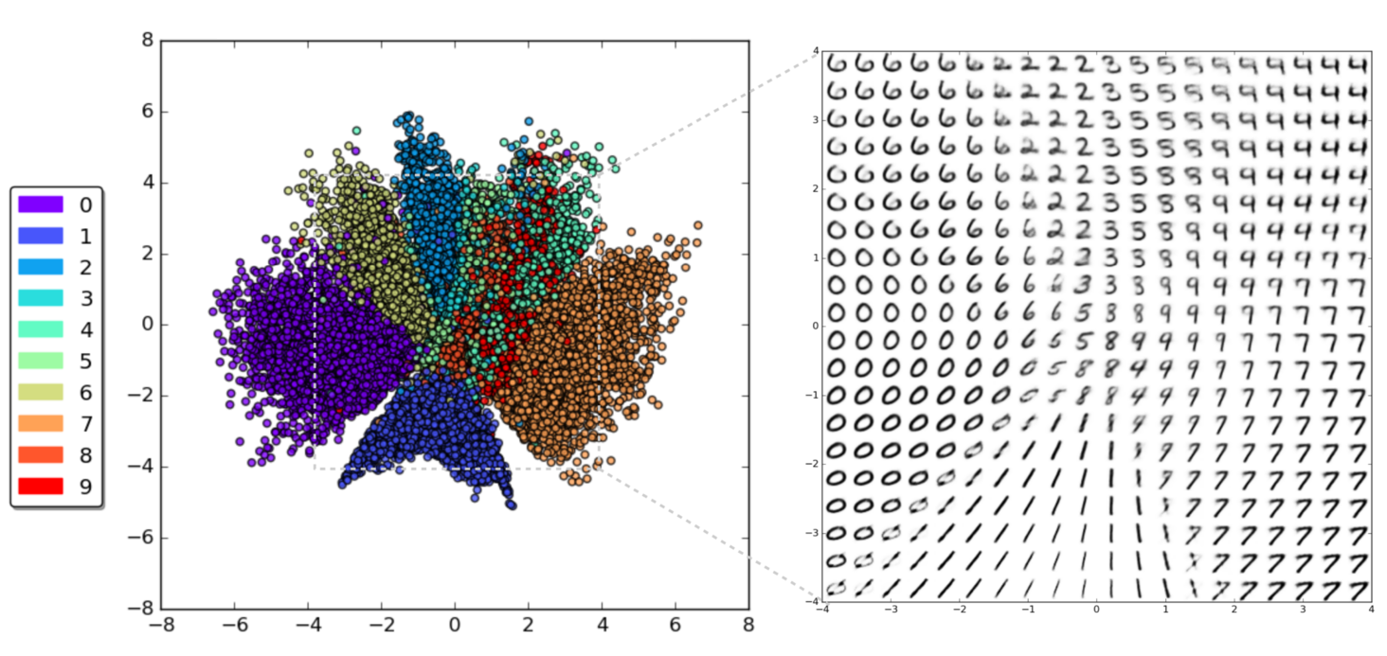
G E N E R A T I V E V I S U A L M O D E L S
Learnerd latent festures space:

Slide 9
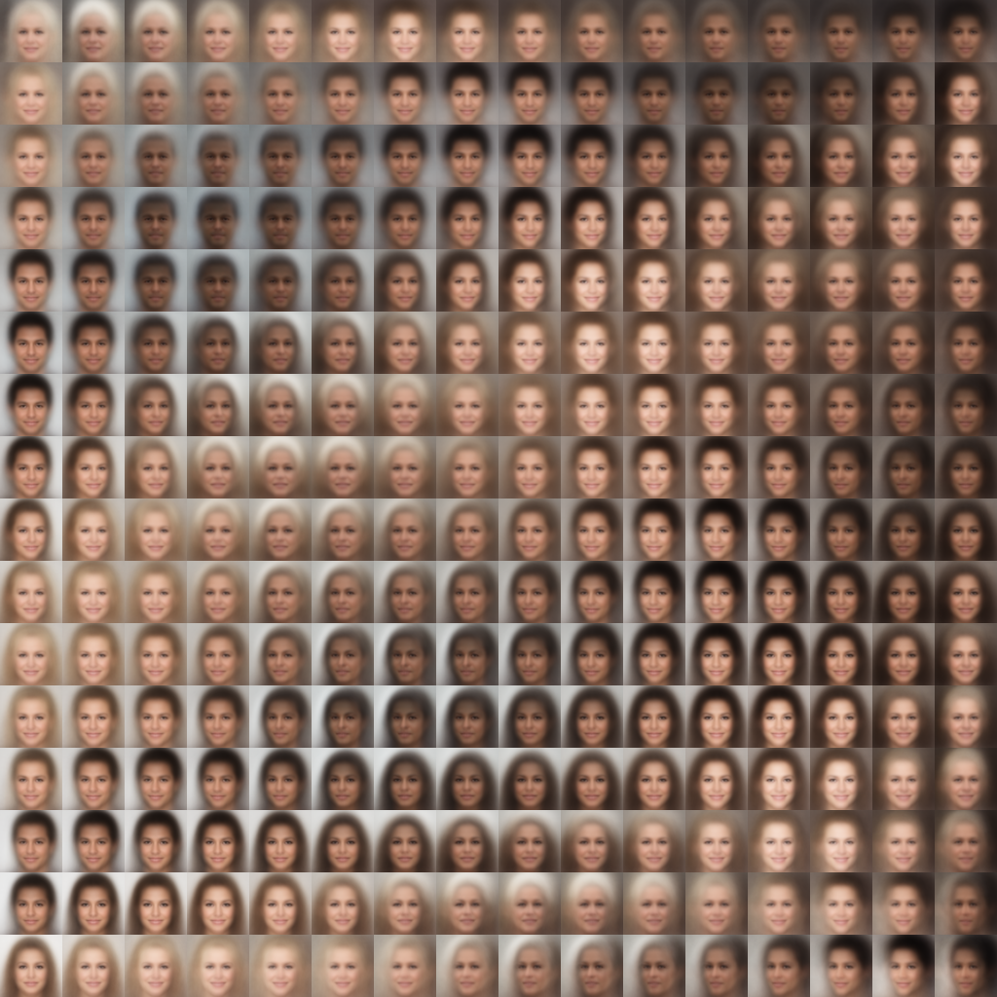
G E N E R A T I V E V I S U A L M O D E L S
Human face manifold learned by VAE:

Slide 11
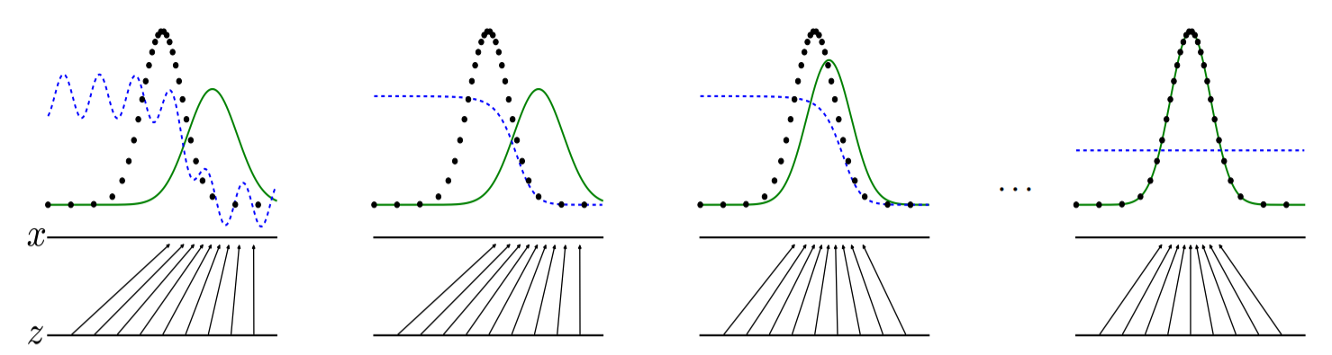

Slide 12
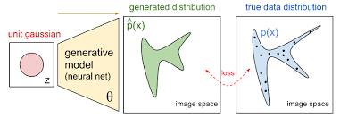

Slide 13
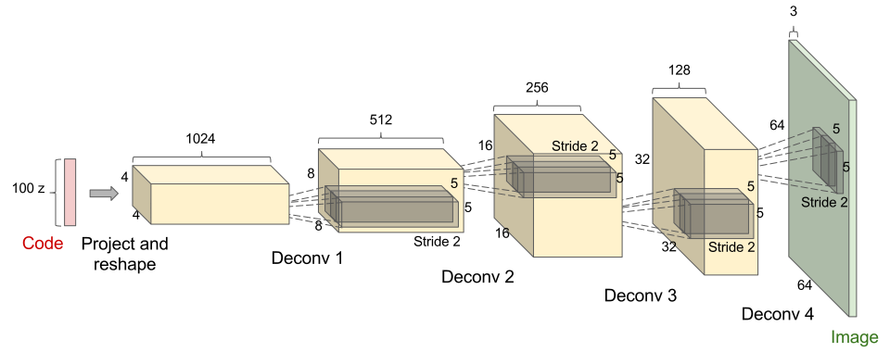
G E N E R A T I V E V I S U A L M O D E L S
Convolutional decoder (generator)

Slide 14
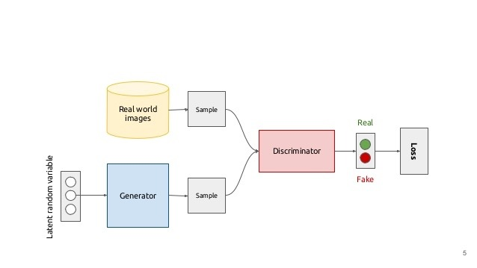
G E N E R A T I V E V I S U A L M O D E L S
Generative adversarial models:

Slide 15
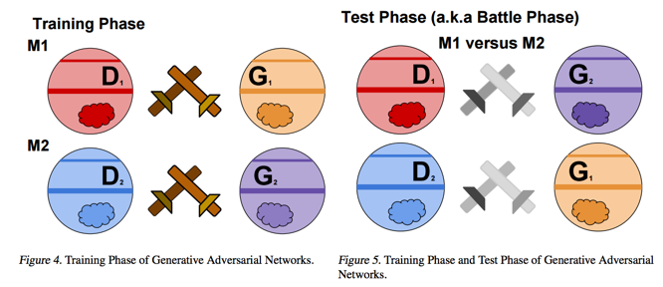
G E N E R A T I V E V I S U A L M O D E L S

Slide 16
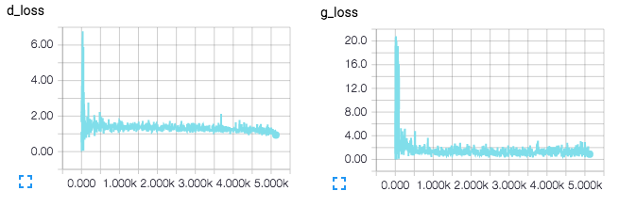
G E N E R A T I V E V I S U A L M O D E L S

Slide 17
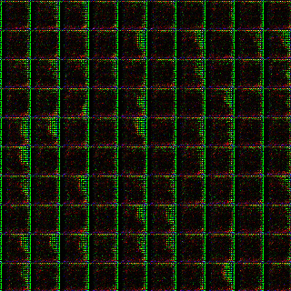

Slide 18
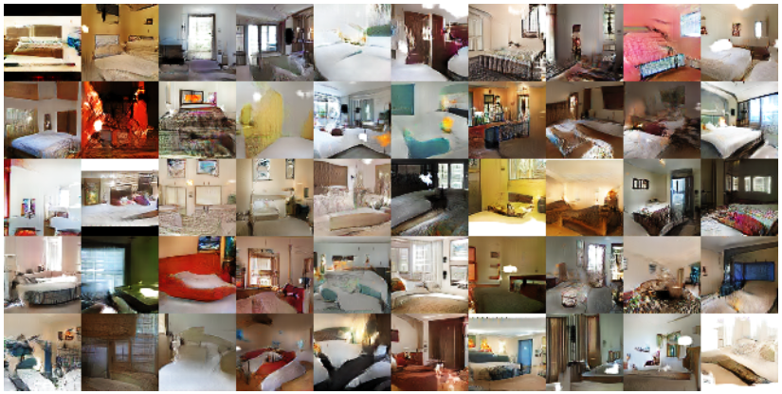
G E N E R A T I V E V I S U A L M O D E L S
Generated bedrooms
Source: “Unsupervised Representation Learning with Deep Convolutional Generative Adversarial Networks” https://arxiv.org/abs/1511.06434v2

Slide 19
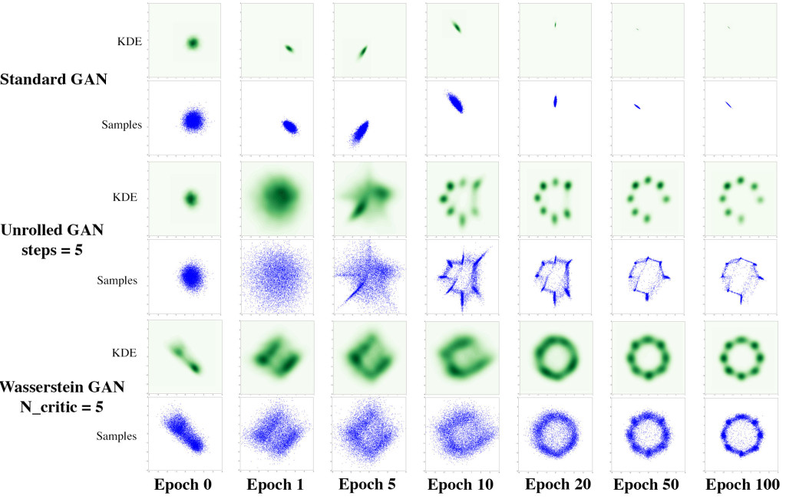
G E N E R A T I V E V I S U A L M O D E L S

Slide 20
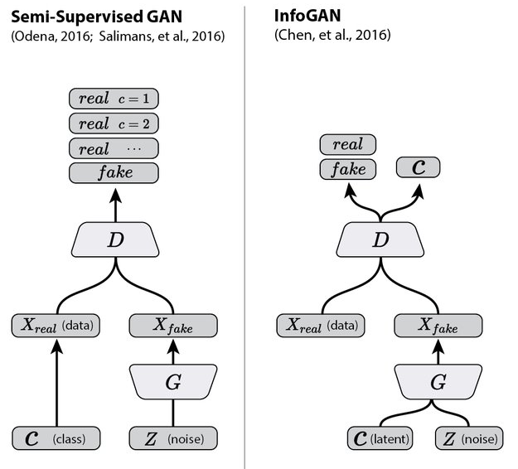
G E N E R A T I V E V I S U A L M O D E L S
GAN improvements:

Slide 21
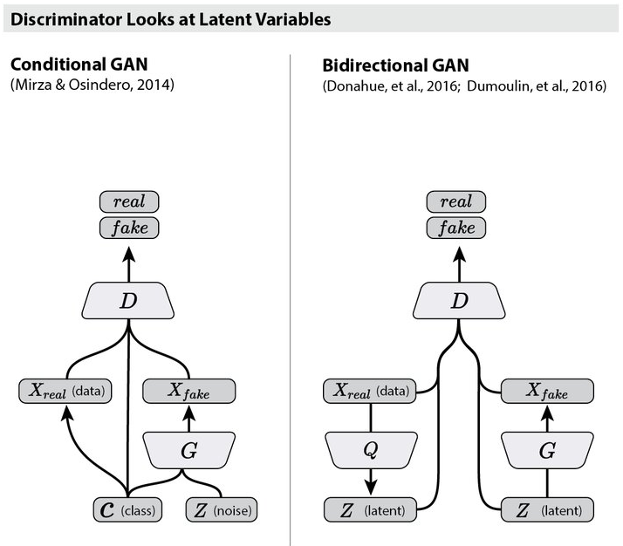
G E N E R A T I V E V I S U A L M O D E L S

Slide 22
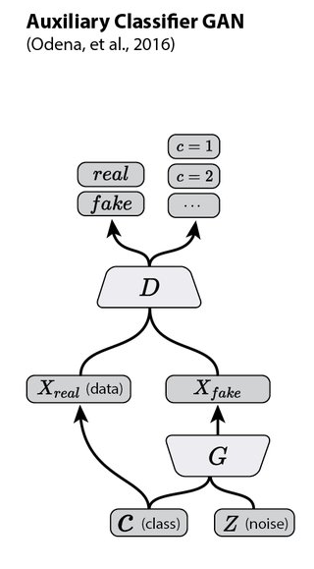
G E N E R A T I V E V I S U A L M O D E L S

Slide 23
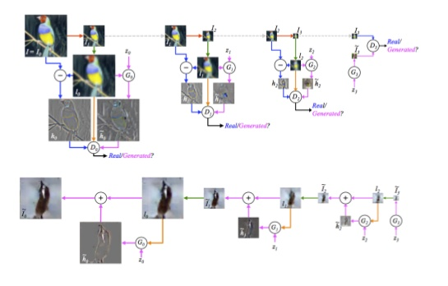
G E N E R A T I V E V I S U A L M O D E L S
Laplacian Pyramid of Generative Models

Slide 24
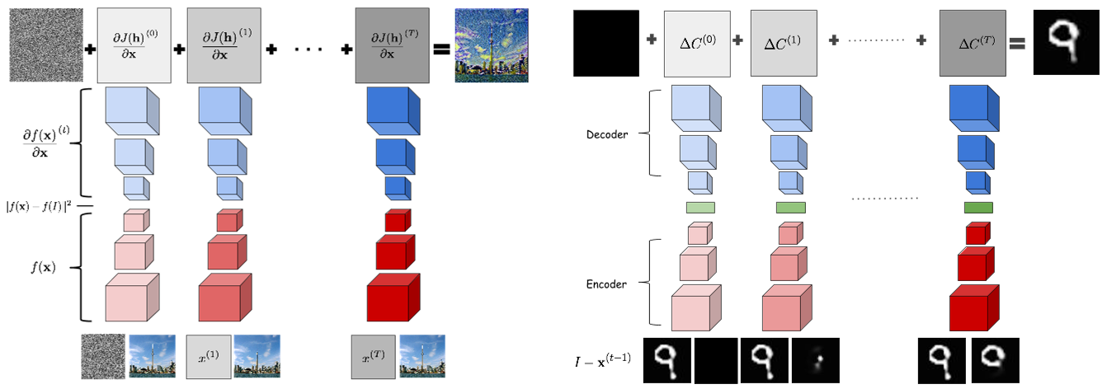
G E N E R A T I V E V I S U A L M O D E L S
Recurrent GAN

Slide 25
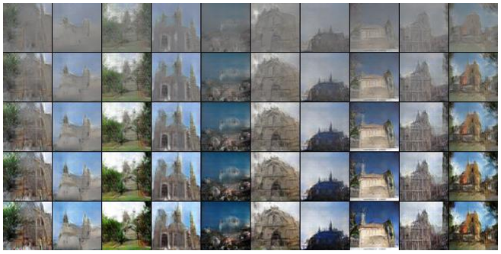
G E N E R A T I V E V I S U A L M O D E L S
Generation progress:

Slide 26
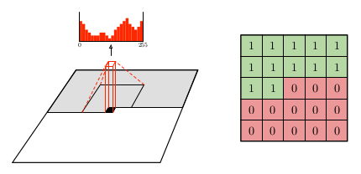
G E N E R A T I V E V I S U A L M O D E L S
Conditional Image Generation with PixelCNN Decoders:

Slide 27
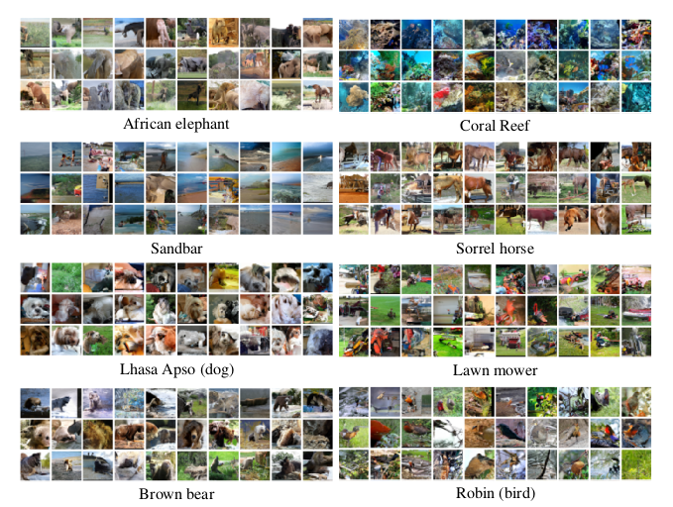
G E N E R A T I V E V I S U A L M O D E L S

Slide 28
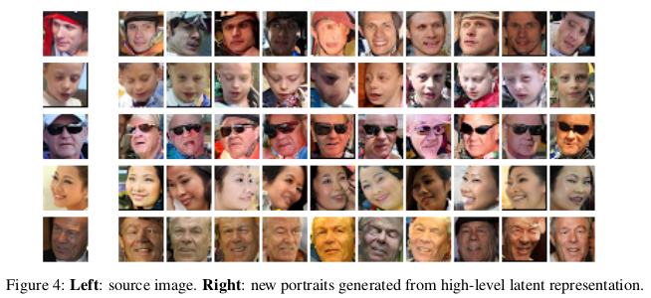
G E N E R A T I V E V I S U A L M O D E L S

Slide 29
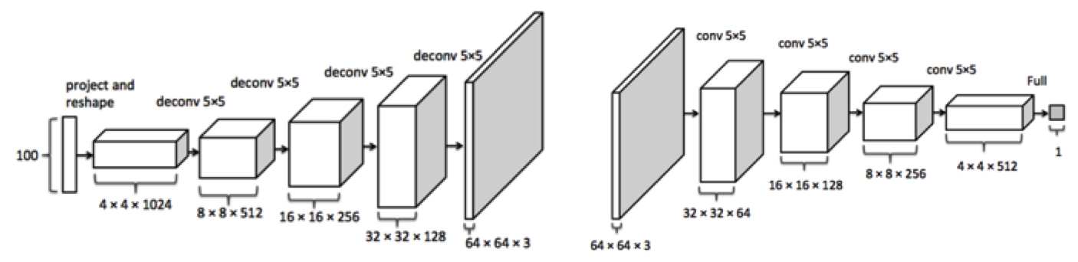
G E N E R A T I V E V I S U A L M O D E L S

Slide 30
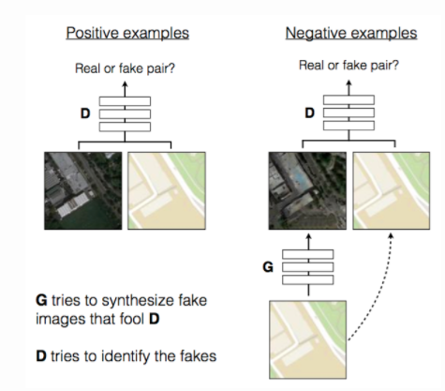
G E N E R A T I V E V I S U A L M O D E L S

Slide 31
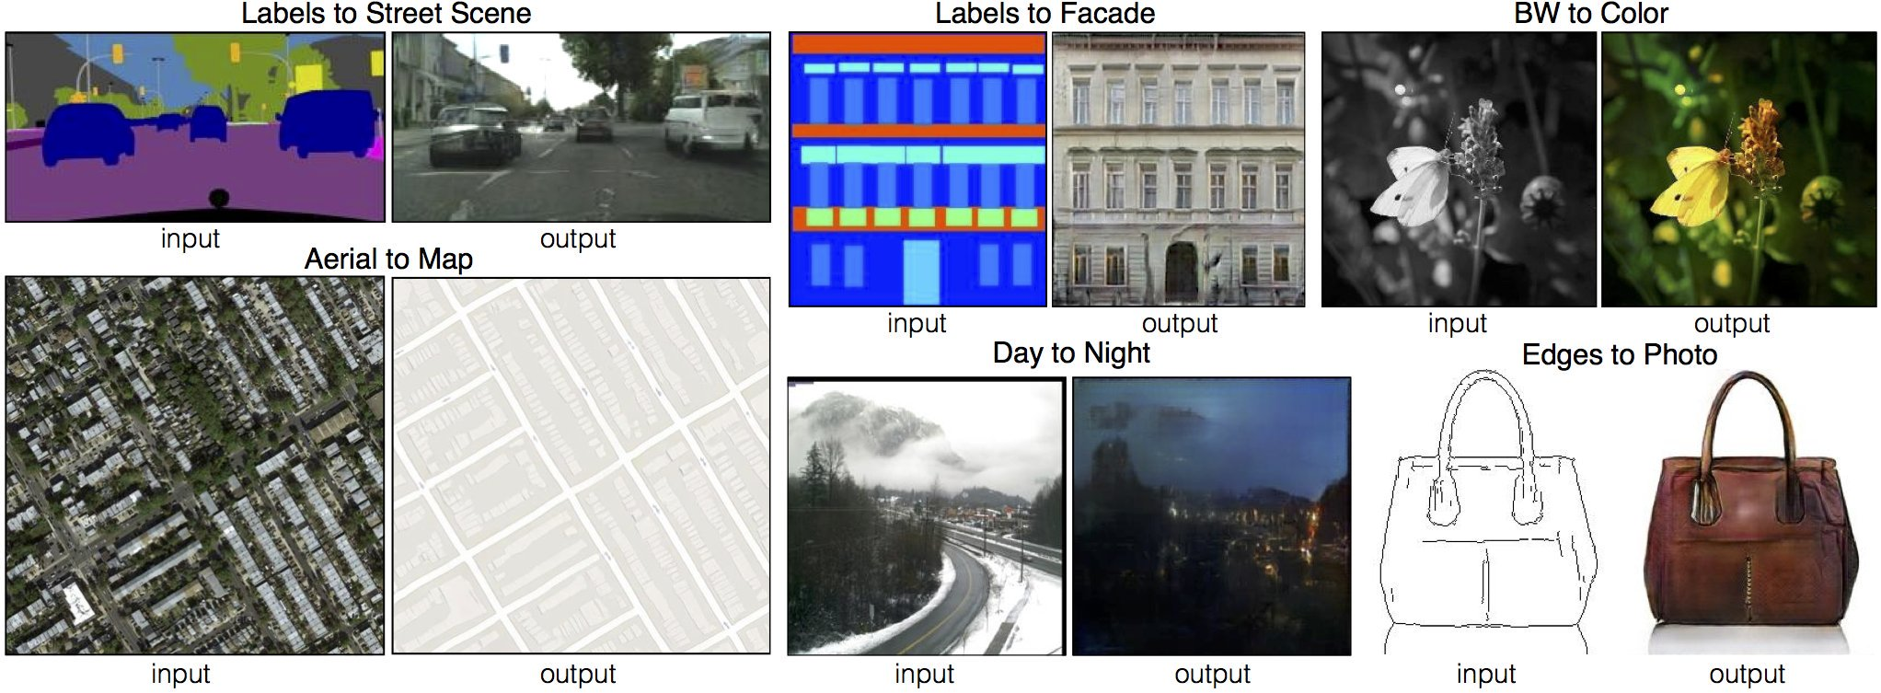

Slide 32
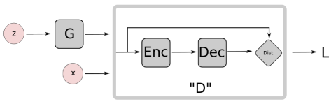
G E N E R A T I V E V I S U A L M O D E L S

Slide 33
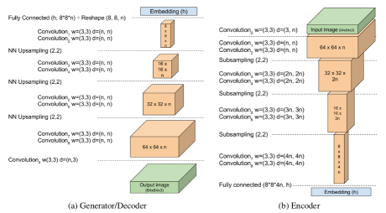
G E N E R A T I V E V I S U A L M O D E L S

Slide 34
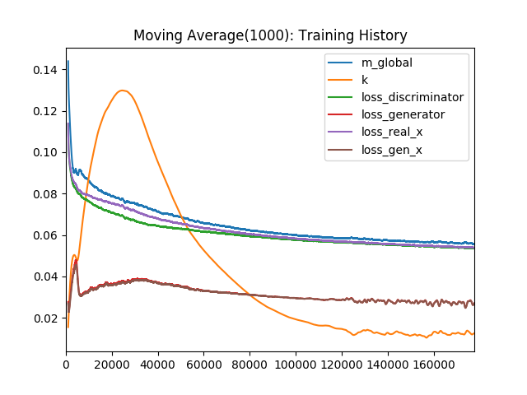
G E N E R A T I V E V I S U A L M O D E L S

Slide 35
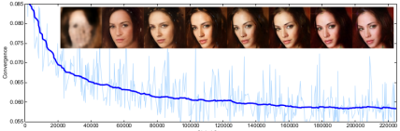
G E N E R A T I V E V I S U A L M O D E L S

Slide 36
GAN Training
Max Pooling => Strided Convolution
ReLu => LeakyReLu
BatchNormalization
Large batch size
Adam or RMSProp

Slide 37
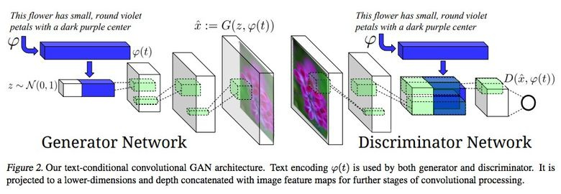
GAN Training

